Slide 1

6th Grade Accelerated Math
Unit 1, Lesson 3 Rewriting Expressions Using the Distributive Property Volume 1, pg. 14

Slide 2


Benchmark
MA.6.NSO.3.2
Rewrite the sum of two composite whole numbers having a common factor, as a common factor multiplied by the sum of two whole numbers.
volume 2, pg. 14

Slide 3
Integrated Mathematical Thinking and Reasoning Standards
MA.K12.MTR.1.1 Actively participate in effortful learning both individually and collectively.
MA.K12.MTR.2.1 Demonstrate understanding by representing problems in multiple ways.
MA.K12.MTR.4.1 Engage in discussions that reflect on the mathematical thinking of self and others.
MA.K12.MTR.5.1 Use patterns and structure to help understand and connect mathematical concepts.
volume 2, pg. 14

Slide 4

Learning Targets
I can use the distributive property to generate equivalent numeric expressions.
I can rewrite the sum of two composite numbers with a common factor using the distributive property.
volume 2, pg. 14

Slide 5

Warm-Up
volume 2, pg. 15

Slide 6
1.3.1 Warm-Up: Secret Number
Juanita has a secret number. Read her clues and answer the questions that follow.
Clue 1: My secret number is a factor of 60.
1. What is the smallest value Juanita’s number could be?
2. What is the largest value Juanita’s number could be?
Clue 2: My number is prime.
3. What values are possible for Juanita’s number at this point?
Clue 3: 15 is a multiple of my secret number.
Clue 4: My secret number is a factor of 20.
4. What is Juanita’s secret number?
5. Could you have determined her secret number only using the first three clues? Explain.
volume 2, pg. 15

Slide 7

Guided Instruction
volume 2, pg. 15

Slide 8
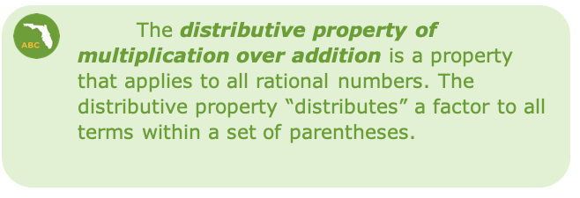
1.3.2 Guided Instruction: The Distributive Property
The product 7 × 23 can be rewritten using the distributive property by decomposing 23 into two parts and multiplying 7 by both parts.
7 × 23 = 7(20 + 3)
7(20 + 3) = (7 ∙ 20) + (7 ∙ 3)
volume 2, pg. 15

Slide 9
1. What are two other ways that 7 × 23 could be rewritten using the distributive property?
7 X 23 = ____ ( ____ + ____ )
7(23) = ____ ( ____ + ____ )
2. Which of the expressions is the easiest to evaluate
using mental math?
The distributive property can also be used to rewrite the sum of two numbers that share a common factor.
volume 2, pg. 15

Slide 10
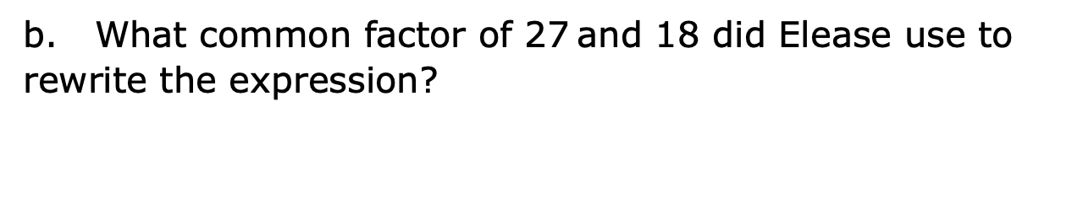
3. Elease rewrote the sum 27 + 18 as 3(9 + 6). Are these two expressions equivalent?
27 + 18 and 3(9 + 6) equivalent
expressions because when evaluated they have
are
are not
the same value.
different values.
b. What common factor of 27 and 18 did Elease use to rewrite the expression?
volume 2, pg. 16

Slide 11
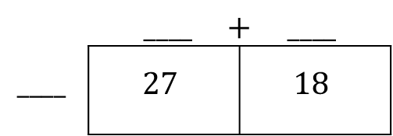

Rewrite the expression 27 + 18 using a different common factor of 27
and 18. Use the area model to support your thinking.
 | $____$ $+$ $____$
$$____$$ | $$27$$ | $$18$$
$$27 + 18 = ____\left( ____ + ____ \right)$$
volume 2, pg. 16

Slide 12

Guided Practice
volume 2, pg. 16

Slide 13

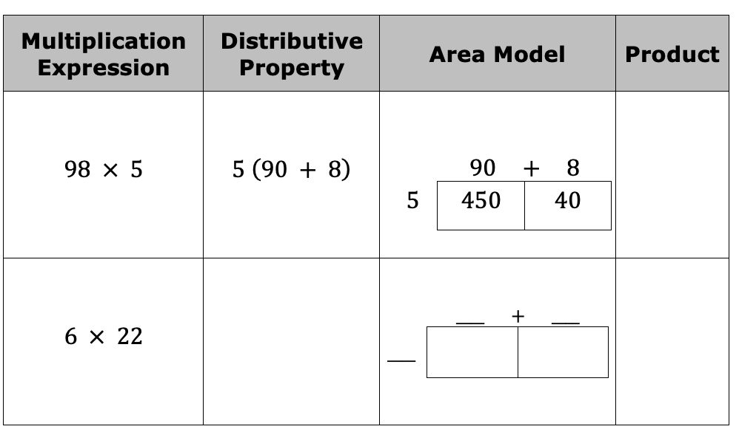
1.3.3 Guided Practice: Rewriting Expressions
Complete the table by rewriting each multiplication expression using the distributive property, modeling with area, and finding the product.
volume 2, pg. 16

Slide 14
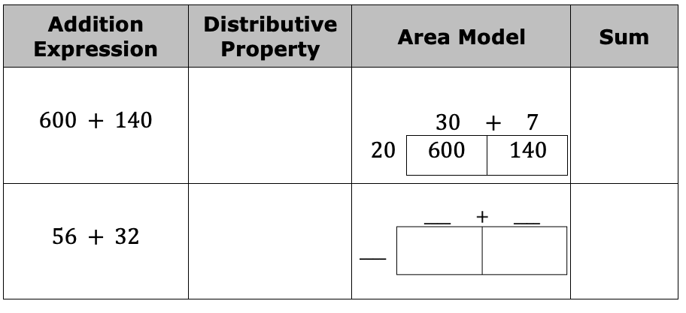
2. Complete the table by rewriting each addition expression using the distributive property, modeling with area, and finding the sum.
volume 2, pg. 16

Slide 15

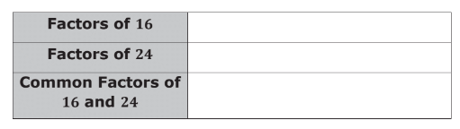
1.3.4 Guided Practice: Rewriting Sums Using Distributive Property
Sums of composite whole numbers can be rewritten using the distributive property and a common factor of the numbers.
A composite number is a whole number greater than that has at least one whole-number factor other than one and itself.
What are the common factors of $16$ and $24$?
volume 2, pg. 17

Slide 16
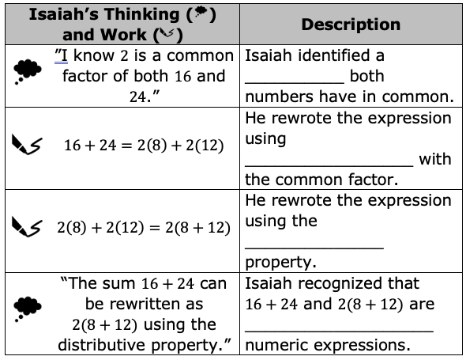
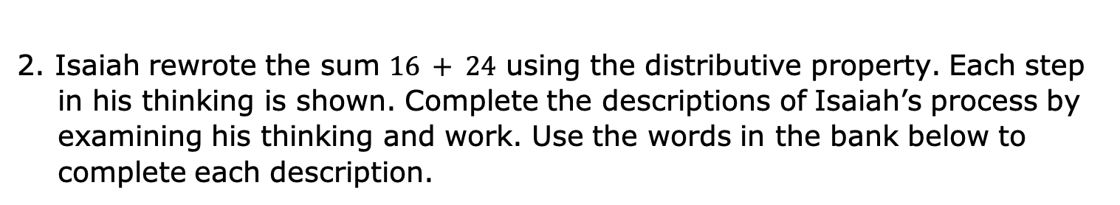
2. Isaiah rewrote the sum $16 + 24$ using the distributive property. Each step in his thinking is shown. Complete the descriptions of Isaiah’s process by examining his thinking and work. Use the words in the bank below to complete each description.
distributive equivalent factor multiplication
volume 2, pg. 17

Slide 17

3. Rewrite the sum $16 + 24$ using the distributive property in two additional ways.
$$16 + 24 = ____ ( ____+____ )$$
$$16 + 24 = ____ ( ____+____ )$$
volume 2, pg. 17

Slide 18
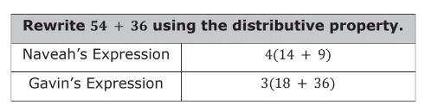
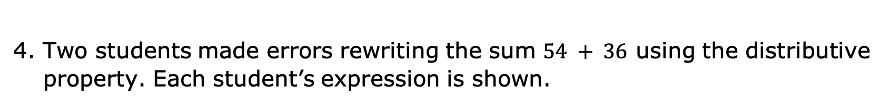
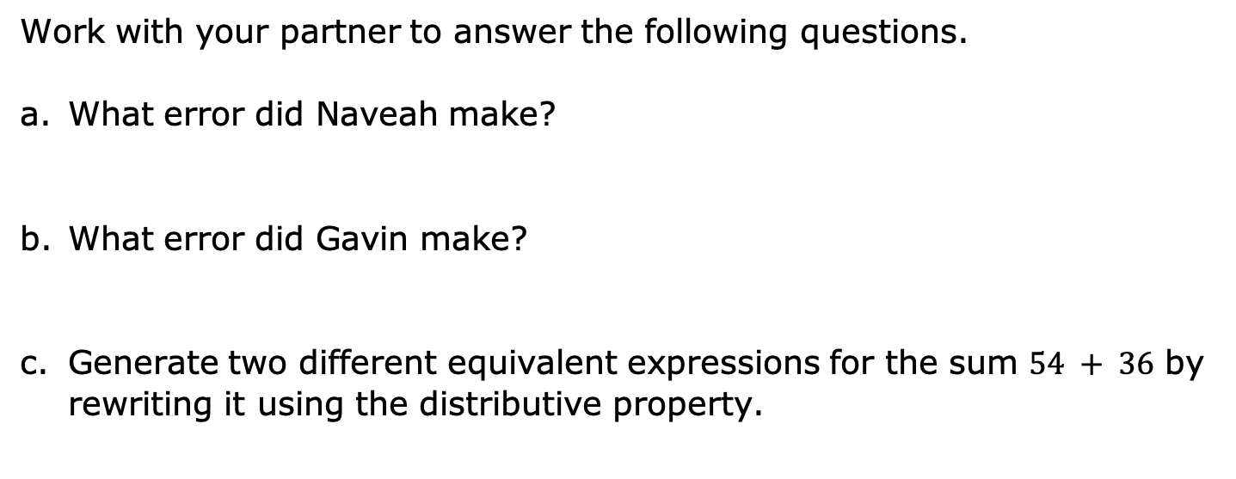
4. Two students made errors rewriting the sum $54 + 36$ using the distributive property. Each student’s expression is shown.
Work with your partner to answer the following questions.
What error did Naveah make?
What error did Gavin make?
Generate two different equivalent expressions for the sum $54 + 36$ by rewriting it using the distributive property.
volume 2, pg. 18

Slide 19
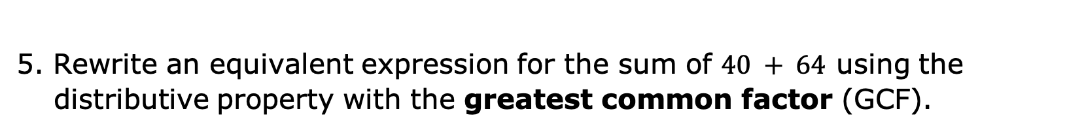
5. Rewrite an equivalent expression for the sum of $40 + 64$ using the distributive property with the greatest common factor (GCF).
volume 2, pg. 18

Slide 20

Collaboration
volume 2, pg. 18

Slide 21





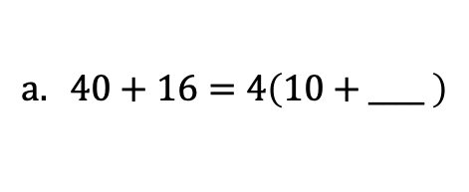

1.3.5 Collaboration: Missing Values
Work with your partner to determine the missing values that make each equation true.
$$a. 40+16=4\left(10+____ \right)$$
b. $15+80=5( ____+ 16)$
c. $108+198=____ \left(6+11\right)$
$$d. 28+63=7\left( ____+____ \right)$$
$$e. 45+18=____ \left( ____+6\right)$$
$$f. 135+27=9\left( ____+3\right)$$
volume 2, pg. 18

Slide 22
2. Choose one of the equations from the table and explain how you determined the missing value(s).
To find the missing value in equation _________, I ____________________________________________
____________________________________________.
3. Have your partner read your explanation and offer suggestions on how to improve it.
volume 2, pg. 18

Slide 23

Your Turn
volume 2, pg. 19

Slide 24




1.3.6 Your Turn!
Rewrite an equivalent expression for each sum using the distributive property with a common factor.
$$a. 51 + 21$$
$$b. 124 + 20$$
c. $72 + 24$
$$d. 39 + 65$$
volume 2, pg. 19

Slide 25
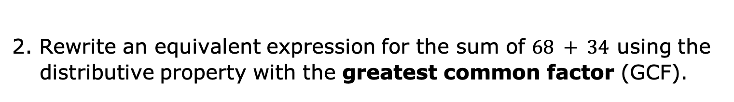
2. Rewrite an equivalent expression for the sum of $68 + 34$ using the distributive property with the greatest common factor (GCF).
volume 2, pg. 19

Slide 26

Wrap-Up
volume 2, pg. 19

Slide 27

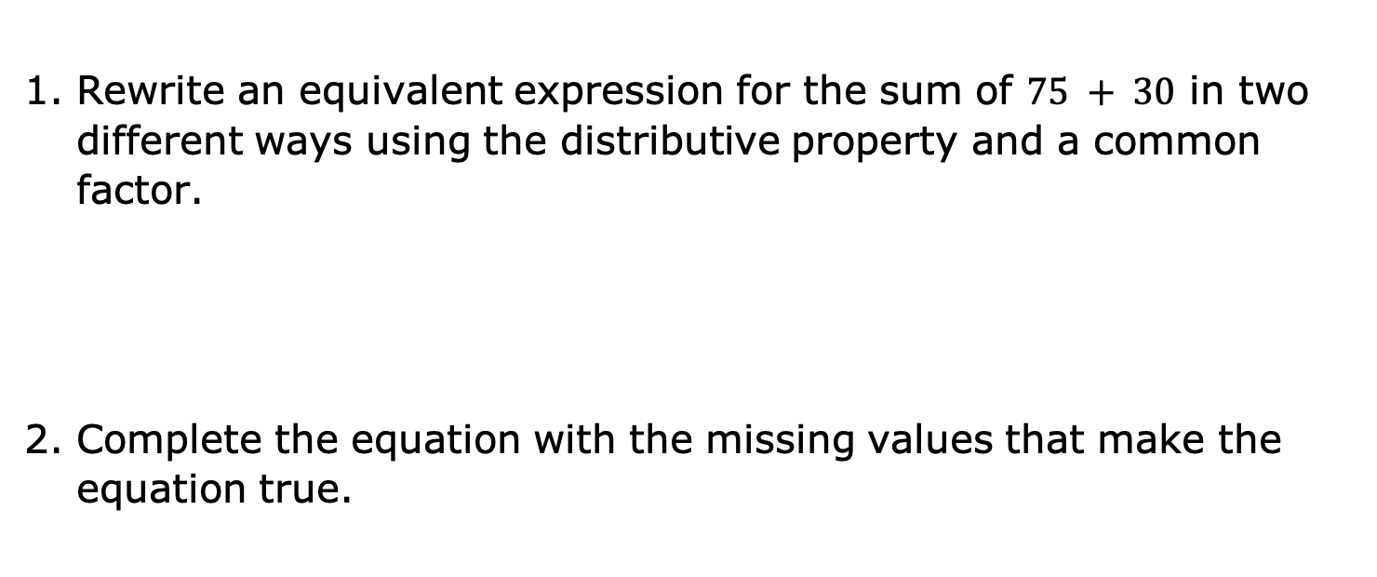
1.3.7 Wrap-Up: Ticket Out the Door
Rewrite an equivalent expression for the sum of $75 + 30$ in two different ways using the distributive property and a common factor.
Complete the equation with the missing values that make the equation true.
$$49+35=____ \left(7+____ \right)$$
volume 2, pg. 19

